Slide 1
DBSCAN Clustering
Density-Based Spatial Clustering of Applications with Noise

Slide 2
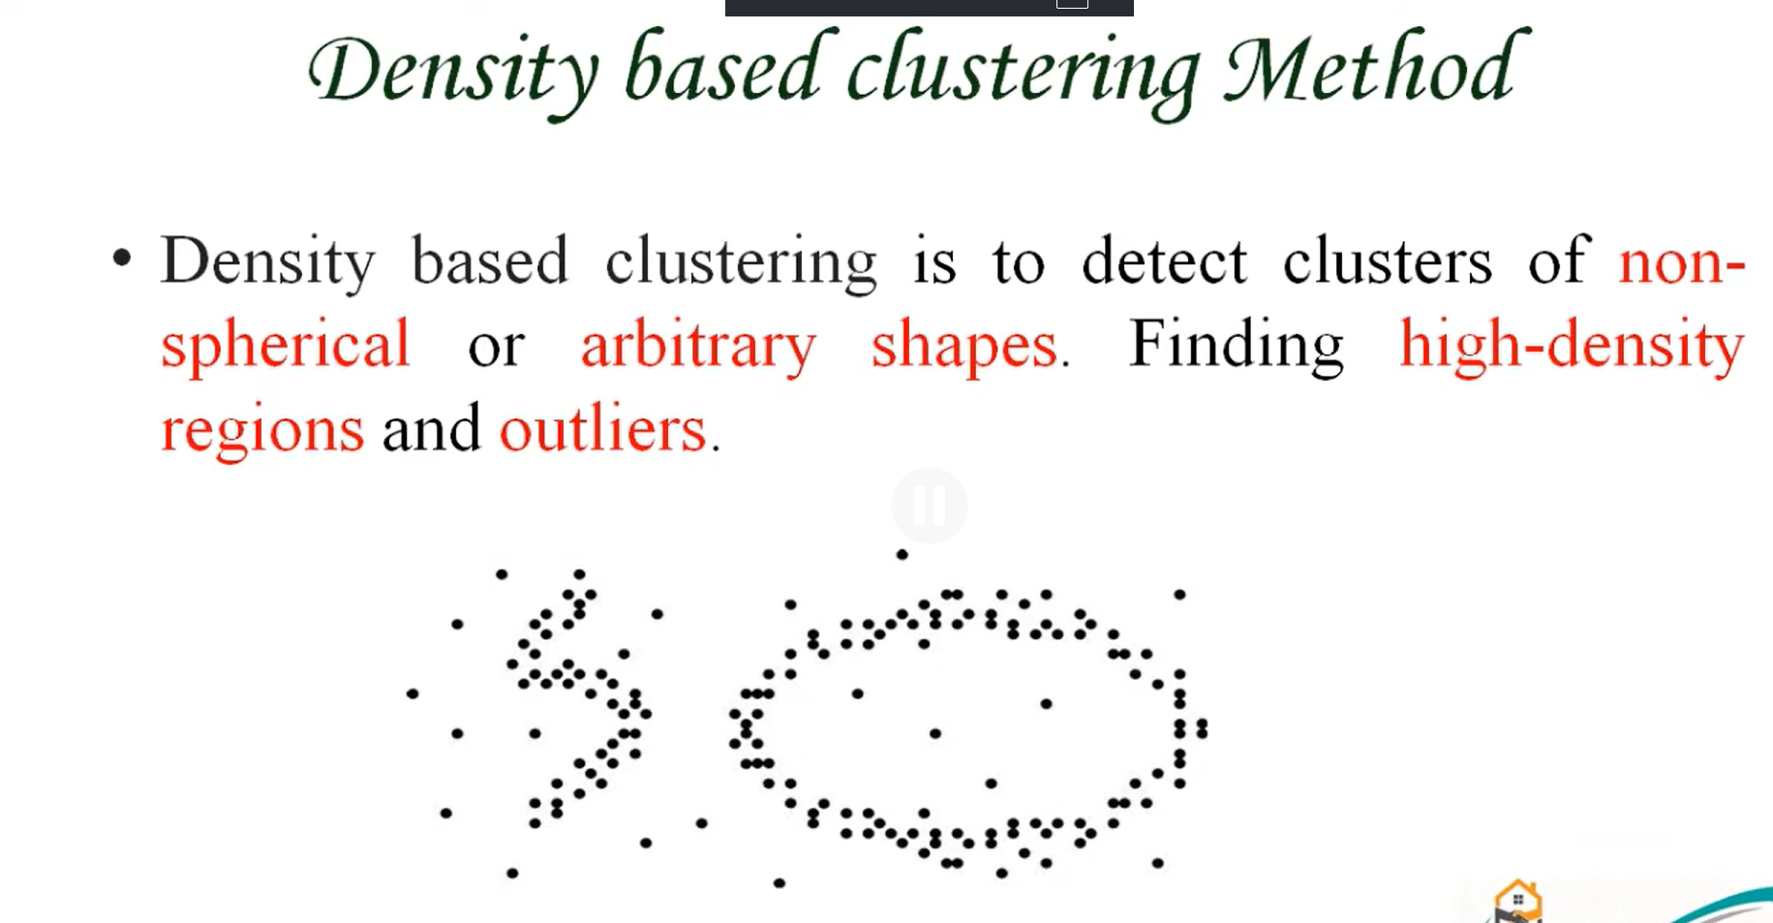

Slide 3
DBSCAN
• Density-Based Spatial Clustering of Applications with Noise (DBSCAN)
• It is able to find arbitrary shaped clusters and clusters with noise (i.e. outliers).
• DBSCAN is a clustering method that is used in machine learning to separate clusters of high density from clusters of low density.

Slide 4
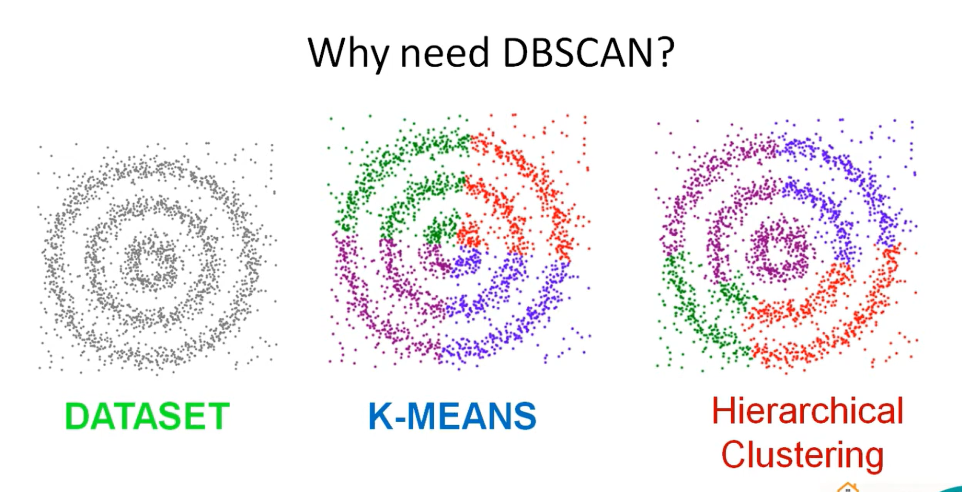

Slide 5
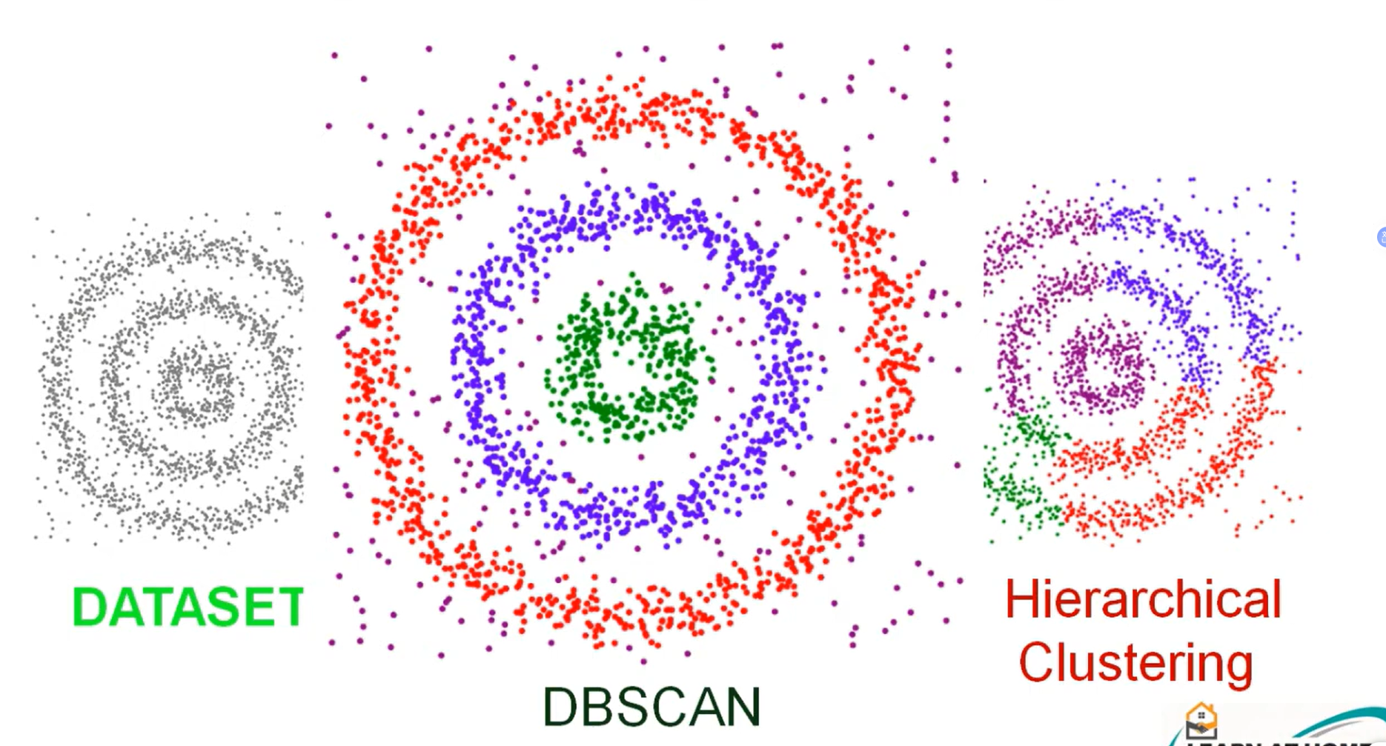

Slide 6
How DBSCAN is Better than K-Means Clustering
Feature | K-Means | DBSCAN
Number of clusters | Must be specified in advance (K) | Found automatically from the data
Cluster shape | Spherical / convex only | Arbitrary shapes (rings, crescents, spirals)
Noise & outliers | Every point is forced into a cluster | Explicitly labels noise points as outliers
Outlier sensitivity | High – outliers drag the centroids | Low – outliers do not affect the clusters
Cluster size / density | Assumes similar-sized clusters | Clusters can be of any size
Initialization | Depends on random centroids; results vary | Deterministic apart from border-point order
Parameters | K | Eps (ε) and MinPts
Best suited for | Compact, well-separated groups | Dense regions separated by sparse areas
Bottom line: DBSCAN handles non-spherical clusters and noise without needing K – exactly where K-Means fails.

Slide 7
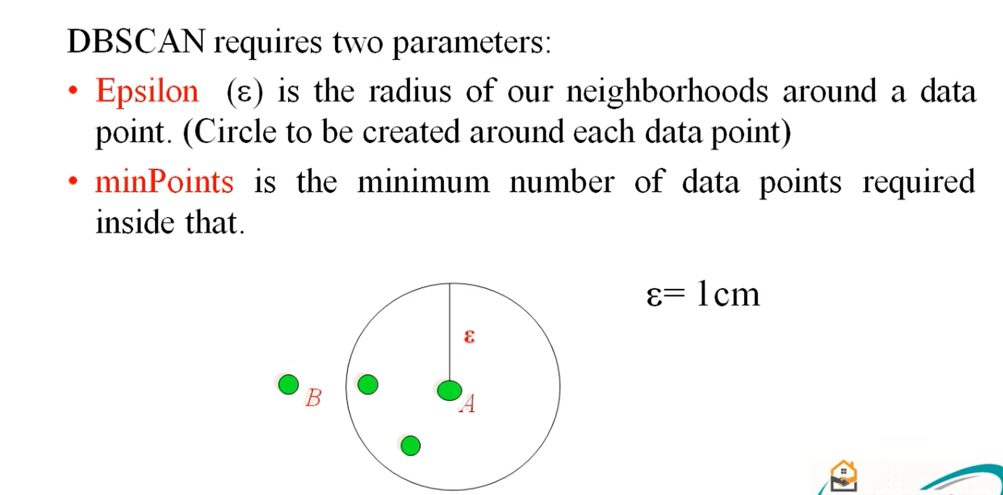

Slide 8
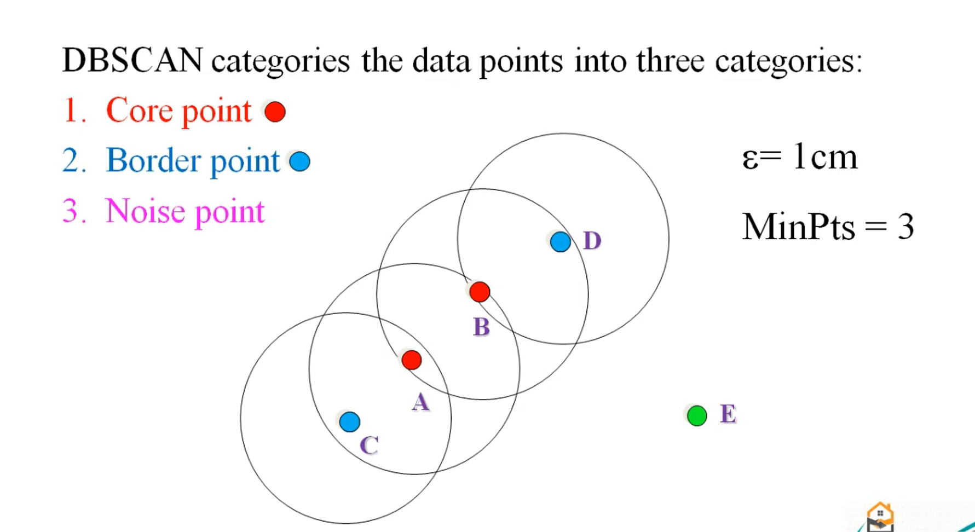

Slide 9
Types of Points
Core point:
A point is a core point if it has more than a specified number of points (MinPts) within Eps.
Border point:
A point is a border point if it is reachable from a core point and there are less than minPts number of points within its surrounding area.
Noise point:
A point is an outlier if it is not a core point and not reachable from any core points.

Slide 10
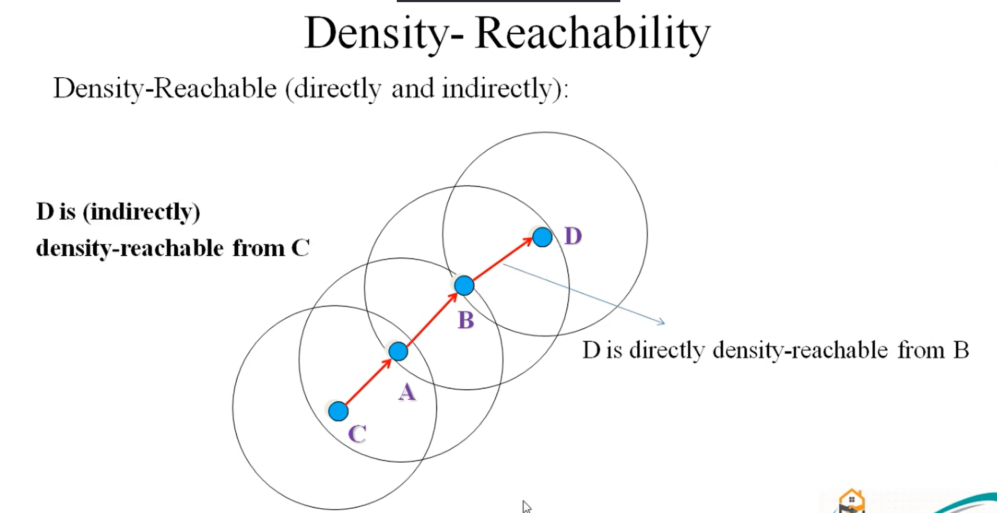

Slide 11
Density Reachability – Definitions
Directly density-reachable
A point q is directly density-reachable from a point p if q lies within ε of p and p is a core point (at least MinPts points within ε).
D
Density-reachable
A point q is density-reachable from p if there is a chain of points p = p₁, p₂, …, pₙ = q such that each pᵢ₊₁ is directly density-reachable from pᵢ.
B
A
Remember
Density-reachability is not symmetric: a border point can be reached from a core point, but not the other way round.
C
D is directly density-reachable from B; D is (indirectly) density-reachable from C

Slide 12
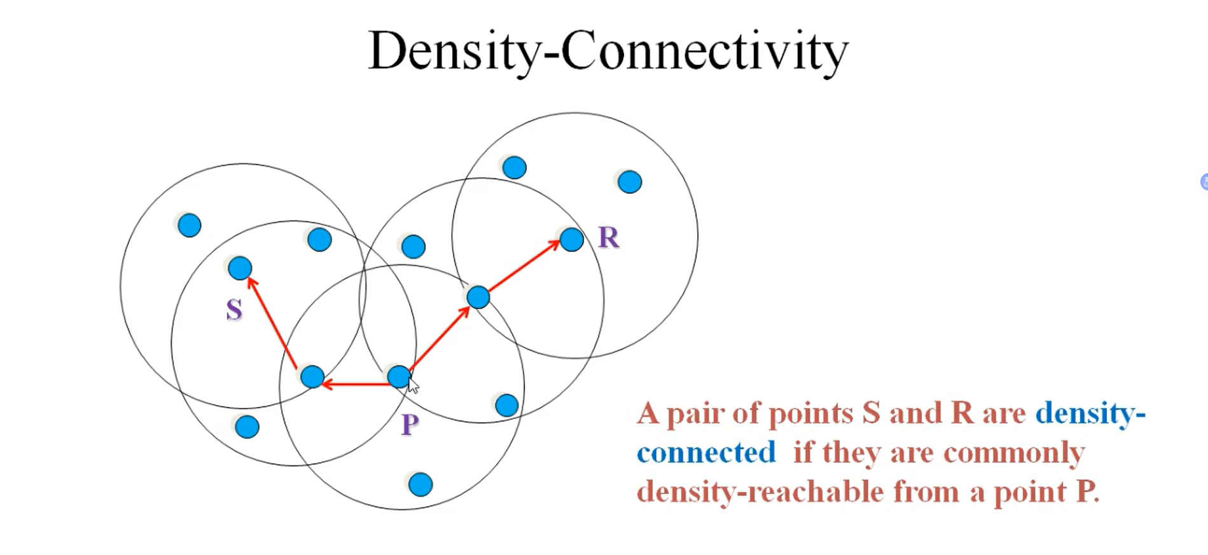

Slide 13
Density Connectivity – Definition
Density-connected
Two points p and q are density-connected if there is a point o such that both p and q are density-reachable from o (with respect to ε and MinPts).
R
Example
S
S and R are density-connected because both are density-reachable from the point P.
P
Why it matters
Density-connectivity is symmetric. A cluster is a maximal set of density-connected points; points connected to no cluster are noise.
S and R are density-connected through P

Slide 14
DBSCAN Algorithm
Input: The data set D
Parameter: ε, MinPts
For each object p in D
if p is a core object and not processed then
C = retrieve all objects density-reachable from p
mark all objects in C as processed
report C as a cluster
else mark p as outlier
end if
End For

Slide 15
Choosing ε and MinPts
Epsilon (ε) – neighbourhood radius
• Plot the sorted k-distance graph (k = MinPts) and pick ε at the “elbow”
• Too small ε → many points become noise
• Too large ε → separate clusters merge into one
MinPts – density threshold
Elbow → choose ε here
• Rule of thumb: MinPts ≥ dimensions + 1, commonly 2 × dimensions
• Use a larger MinPts for noisy or large datasets
• Features should be scaled before computing distances

Slide 16
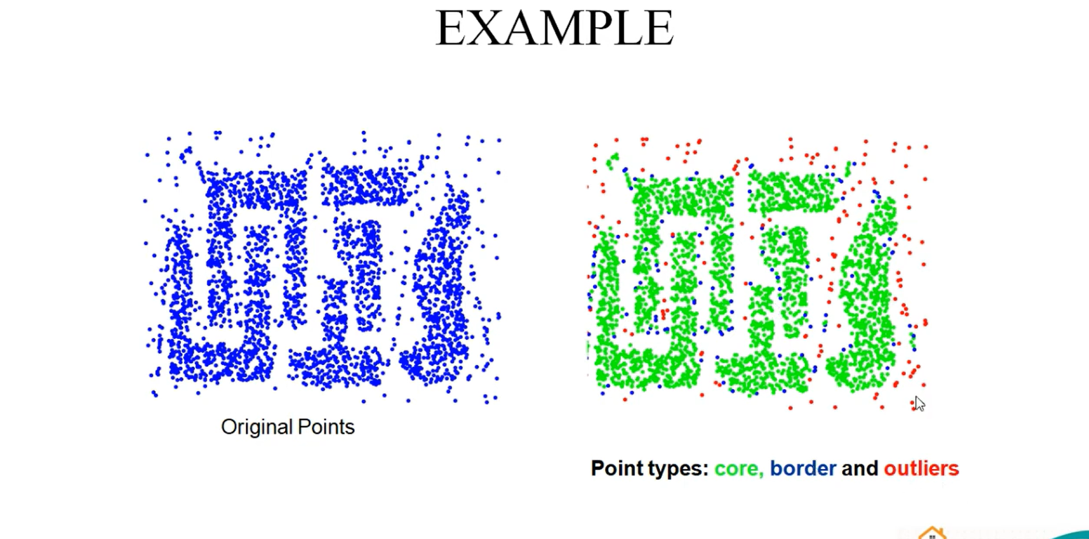

Slide 17
DBSCAN Clustering Algorithm Solved Example – 1
• Apply the DBSCAN algorithm to the given data points and
• Create the clusters with
• minPts = 4 and
• epsilon (ε) = 1.9.
Data Points:
P1: (3, 7)
P3: (5, 5)
P5: (7, 3)
P7: (7, 2)
P9: (3, 3)
P11: (3, 5)
P2: (4, 6)
P4: (6, 4)
P6: (6, 2)
P8: (8, 4)
P10: (2, 6)
P12: (2, 4)

Slide 18
DBSCAN Clustering Algorithm Solved Example
Step 1:
• To find the core points, boundary points and outliers by using DBSCAN we need to first calculate the distance among all pairs of given data points.
• Let us use Euclidean distance measure for distance calculation.
P₁(x₁, y₁) and P₂(x₂, y₂)
dist(p₁, p₂) = √((x₂ − x₁)² + (y₂ − y₁)²)

Slide 19
DBSCAN Clustering Algorithm Solved Example – 1
• Use Euclidean distance and calculate the distance between each points.
Distance(A(x₁, y₁), B(x₂, y₂)) = √((x₂ − x₁)² + (y₂ − y₁)²)

Slide 20
DBSCAN Clustering Algorithm Solved Example – 1
minPts = 4 and epsilon (ε) = 1.9
P1: (3, 7)
P2: (4, 6)
P3: (5, 5)
P4: (6, 4)
P5: (7, 3)
P6: (6, 2)
P7: (7, 2)
P8: (8, 4)
P9: (3, 3)
P10: (2, 6)
P11: (3, 5)
P12: (2, 4)
 | P1 | P2 | P3 | P4 | P5 | P6 | P7 | P8 | P9 | P10 | P11 | P12
P1 | 0
P2 | 1.41 | 0
P3 | 2.83 | 1.41 | 0
P4 | 4.24 | 2.83 | 1.41 | 0
P5 | 5.66 | 4.24 | 2.83 | 1.41 | 0
P6 | 5.83 | 4.47 | 3.16 | 2.00 | 1.41 | 0
P7 | 6.40 | 5.00 | 3.61 | 2.24 | 1.00 | 1.00 | 0
P8 | 5.83 | 4.47 | 3.16 | 2.00 | 1.41 | 2.83 | 2.24 | 0
P9 | 4.00 | 3.16 | 2.83 | 3.16 | 4.00 | 3.16 | 4.12 | 5.10 | 0
P10 | 1.41 | 2.00 | 3.16 | 4.47 | 5.83 | 5.66 | 6.40 | 6.32 | 3.16 | 0
P11 | 2.00 | 1.41 | 2.00 | 3.16 | 4.47 | 4.24 | 5.00 | 5.10 | 2.00 | 1.41 | 0
P12 | 3.16 | 2.83 | 3.16 | 4.00 | 5.10 | 4.47 | 5.39 | 6.00 | 1.41 | 2.00 | 1.41 | 0

Slide 21
DBSCAN Clustering Algorithm Solved Example – 1
minPts = 4 and epsilon (ε) = 1.9
P1: P2, P10
P2: P1, P3, P11
P3: P2, P4
P4: P3, P5
P5: P4, P6, P7, P8
P6: P5, P7
P7: P5, P6
P8: P5
P9: P12
P10: P1, P11
P11: P2, P10, P12
P12: P9, P11
 | P1 | P2 | P3 | P4 | P5 | P6 | P7 | P8 | P9 | P10 | P11 | P12
P1 | 0
P2 | 1.41 | 0
P3 | 2.83 | 1.41 | 0
P4 | 4.24 | 2.83 | 1.41 | 0
P5 | 5.66 | 4.24 | 2.83 | 1.41 | 0
P6 | 5.83 | 4.47 | 3.16 | 2.00 | 1.41 | 0
P7 | 6.40 | 5.00 | 3.61 | 2.24 | 1.00 | 1.00 | 0
P8 | 5.83 | 4.47 | 3.16 | 2.00 | 1.41 | 2.83 | 2.24 | 0
P9 | 4.00 | 3.16 | 2.83 | 3.16 | 4.00 | 3.16 | 4.12 | 5.10 | 0
P10 | 1.41 | 2.00 | 3.16 | 4.47 | 5.83 | 5.66 | 6.40 | 6.32 | 3.16 | 0
P11 | 2.00 | 1.41 | 2.00 | 3.16 | 4.47 | 4.24 | 5.00 | 5.10 | 2.00 | 1.41 | 0
P12 | 3.16 | 2.83 | 3.16 | 4.00 | 5.10 | 4.47 | 5.39 | 6.00 | 1.41 | 2.00 | 1.41 | 0
Highlighted: distance ≤ ε (1.9) → neighbours

Slide 22
DBSCAN Clustering Algorithm Solved Example – 1
minPts = 4 and epsilon (ε) = 1.9
P1: P2, P10
P2: P1, P3, P11
P3: P2, P4
P4: P3, P5
P5: P4, P6, P7, P8
P6: P5, P7
P7: P5, P6
P8: P5
P9: P12
P10: P1, P11
P11: P2, P10, P12
P12: P9, P11
Point | Status
P1 | Noise | Border
P2 | Core
P3 | Noise | Border
P4 | Noise | Border
P5 | Core
P6 | Noise | Border
P7 | Noise | Border
P8 | Noise | Border
P9 | Noise
P10 | Noise | Border
P11 | Core
P12 | Noise | Border

Slide 23
DBSCAN Clustering Algorithm Solved Example – 1
minPts = 4 and epsilon (ε) = 1.9
P1: P2, P10
P2: P1, P3, P11
P3: P2, P4
P4: P3, P5
P5: P4, P6, P7, P8
P6: P5, P7
P7: P5, P6
P8: P5
P9: P12
P10: P1, P11
P11: P2, P10, P12
P12: P9, P11

Slide 24
DBSCAN Clustering Algorithm Solved Example
• Given the points
• A(3, 7), B(4, 6), C(5, 5), D(6, 4), E(7, 3), F(6, 2), G(7, 2) and H(8, 4)
• Find the core points, boundary points and outliers using DBSCAN.

Slide 25
DBSCAN Clustering Algorithm Solved Example
• Given,
• Epsilon (Eps) = 2.5
• Minimum Points (MinPts) = 3
• Let’s represent the given data points in tabular form:
Data Points | X | Y
A | 3 | 7
B | 4 | 6
C | 5 | 5
D | 6 | 4
E | 7 | 3
F | 6 | 2
G | 7 | 2
H | 8 | 4

Slide 26
DBSCAN Clustering Algorithm Solved Example
In the table, Distance ≤ Epsilon (i.e. 2.5) is marked red.
Data Points | A | B | C | D | E | F | G | H
A | 0 | 1.4142 | 2.8284 | 4.2426 | 5.6569 | 5.8310 | 6.4031 | 5.8310
B |  | 0 | 1.4142 | 2.8284 | 4.2426 | 4.4721 | 5 | 4.4721
C |  |  | 0 | 1.4142 | 2.8284 | 3.1623 | 3.6056 | 3.1623
D |  |  |  | 0 | 1.4142 | 2 | 2.2361 | 2
E |  |  |  |  | 0 | 1.4142 | 1 | 1.4142
F |  |  |  |  |  | 0 | 1 | 2.8284
G |  |  |  |  |  |  | 0 | 2.2361
H |  |  |  |  |  |  |  | 0
A(3, 7)
B(4, 6)
C(5, 5)
D(6, 4)
E(7, 3)
F(6, 2)
G(7, 2)
H(8, 4)

Slide 27
DBSCAN Clustering Algorithm Solved Example
• Here, data points A, B and C have
• neighbors < MinPts (i.e. 3)
• So can’t be considered as core points
• Since they belong to the neighborhood of other data points, hence, there exist no outliers in the given data points.
• A, B and C are non-core points and not outliers hence they are called boundary points.
N(A) = {B};
N(B) = {A, C};
N(C) = {B, D};
N(D) = {C, E, F, G, H};
N(E) = {D, F, G, H};
N(F) = {D, E, G};
N(G) = {D, E, F, H};
N(H) = {D, E, G};

Slide 28
Advantages & Disadvantages
Advantages
Disadvantages
1) Does not require a-priori specification of number of clusters.
2) Able to identify noise data while clustering.
3) DBSCAN algorithm is able to find arbitrarily size and arbitrarily shaped clusters.
1) DBSCAN algorithm fails in case of varying density clusters.
2) Fails in case of neck type of dataset.

Slide 29
Applications of DBSCAN
1
2
3
Anomaly & fraud detection
Geospatial analysis
Image processing
Noise points flag unusual transactions or behaviour
Find hotspots from GPS, crime or accident locations
Segment regions and detect objects of arbitrary shape
4
5
6
Customer segmentation
Sensor & network data
Science & bioinformatics
Group buyers by density of behaviour, spot outlier customers
Detect faults and intrusions in streaming data
Cluster galaxies, gene expression and cell data

Slide 30
Key Takeaways
Density-based
Clusters are dense regions of points separated by sparse regions.
1
Three point types
Core, border and noise points – defined by ε and MinPts.
2
No K needed
The number of clusters comes from the data, not from the user.
3
Robust to outliers
Noise is labelled instead of being forced into a cluster.
4
Limitations
Struggles with varying densities and high-dimensional data; sensitive to ε.
5

